Slide 1
Basketball Analysis Using Open pose
Bharathsimha Reddy Athuru (12301014)
Subramanya Ramesh (12400865)
Farhan Fazal (12401050)
Utkala Divi (12301052)

Slide 2
Introduction
Basketball is a high-performance sport that demands consistent player efficiency in every game.
To achieve optimal results, sports analysts utilize OpenPose and computer vision to analyze player performance across various positions on the court.
This Basketball Analysis project leverages machine learning and computer visison to analyze basketball shots and shooting poses.
By utilizing Open Pose, a cutting-edge human pose estimation technology, this application provides in-depth analysis of shooting form, counting shot attempts, and determining shot outcomes.
This project aims to enhance basketball training and performance through advanced AI-driven insights.

Slide 3
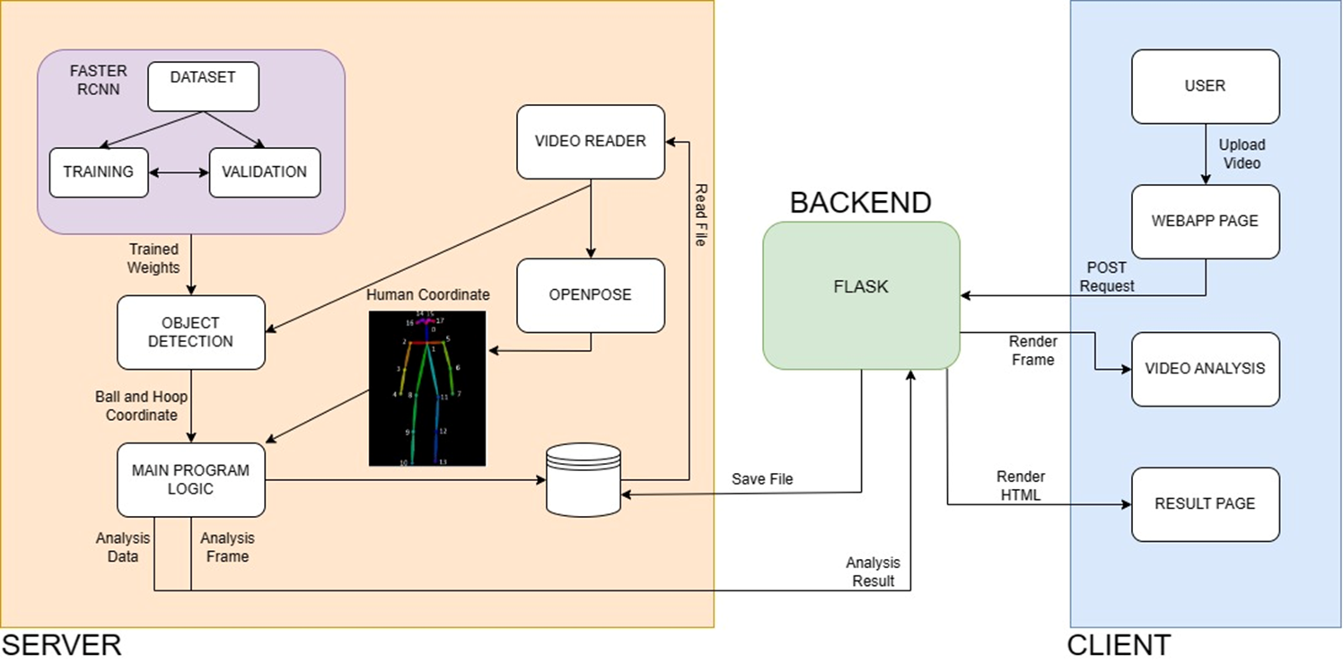
Architecture

Slide 4
Architecture Overview
Server Side:
Faster R-CNN: Trains and validates object detection models using a dataset, producing trained weights.
TensorFlow Object Detection: Identifies ball and hoop coordinates in video frames.
Open Pose: Analyses human coordinates from video frames and generates processed videos.
Main Program Logic:
Processes analysis data and frames, creating detailed traces and fitting images.
Backend:
Flask Framework: Manages POST requests from the client, processes video files, and returns analysis results.
Client Side:
User Interaction: Users upload videos via a web app page.
Web App Page & Result Display:Sends POST requests to the server, displays rendered frames, and presents the final analysis results.

Slide 5
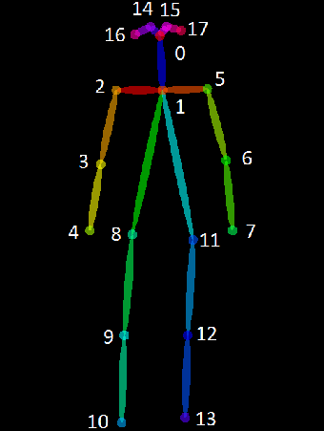
Open Pose
Open Pose is an open-source library for real-time multi-person key point detection and pose estimation from images or videos.
It accurately identifies and tracks human body key points, such as joints and body parts.
Applications in sports analytics, gesture recognition, and human movement analysis.

Slide 6
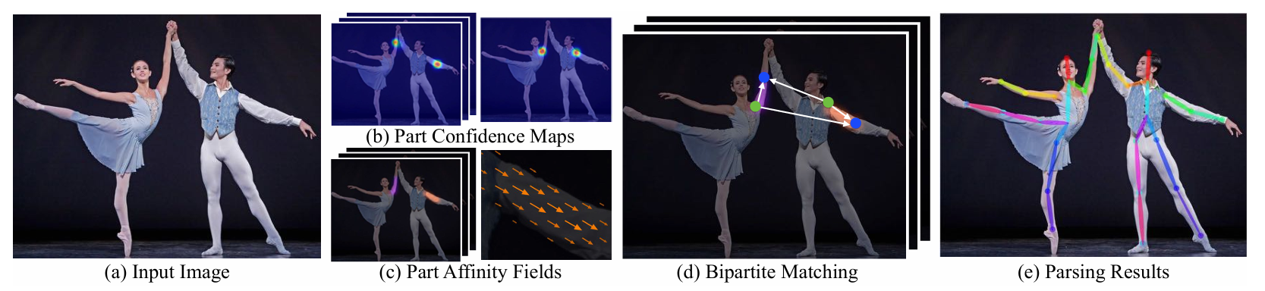
Open Pose
Multi-Stage Convolutional Neural Networks (CNNs): Open Pose utilizes a series of multi-stage networks for feature extraction and refinement. These networks are designed to process image data and extract relevant features that aid in key points detection.
Part Confidence Maps: Open Pose generates heatmap representations for each key point of interest (e.g., elbows, knees) across multiple scales. These heatmaps represent the likelihood of a key point being located at each pixel, which helps in precise localization.
Part Affinity Fields (PAFs): PAFs are a set of 2D vector fields that encode the location and orientation of body parts relative to each other. They are crucial for associating body parts and forming connections between key points.

Slide 7
Open Pose
Open Pose accurately detects and tracks key body keypoints such as elbows and knees during basketball shots from video inputs.
It provides crucial metrics like release angle and timing based on these key points, essential for evaluating shooting technique and performance.
Open Pose's outputs enhance object detection models (like Faster R-CNN) by enriching the analysis with detailed human pose data, improving the accuracy of shot detection and classification (score, miss, undetermined).

Slide 8
Faster Region Based Convolution Neural Network(RCNN)
Faster R-CNN (Region-based Convolutional Neural Network) is a deep learning framework used for object detection tasks. Here’s what it does in a nutshell:
Region Proposal Network (RPN): Faster R-CNN integrates an RPN that efficiently proposes regions of interest (ROIs) in an image, which are likely to contain objects.
Feature Extraction: It uses a CNN backbone (like VGG16 or ResNet) to extract features from the entire image.
ROI Pooling and Classification: After generating ROIs, Faster R-CNN uses ROI pooling to extract fixed-size feature maps from each ROI, which are then classified using fully connected layers to determine the presence of objects and their classes.
End-to-End Training: The entire network is trained end-to-end, allowing it to learn to localize and classify objects in a single integrated framework, achieving high accuracy in object detection tasks.

Slide 9
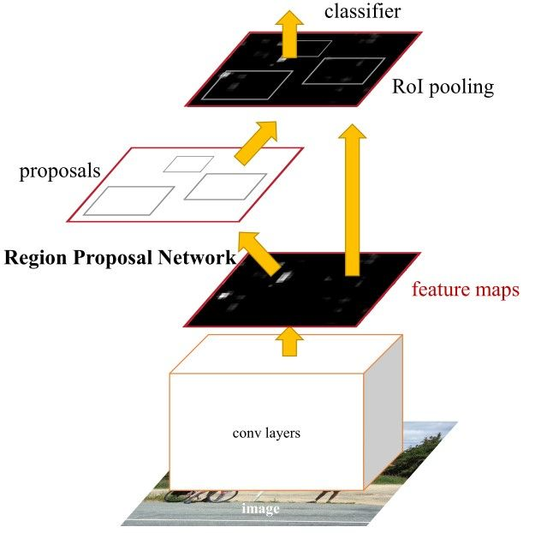
FRCNN
Object Detection: Faster R-CNN is employed to detect basketballs within images or video frames. This allows the system to pinpoint the exact location of the basketball in various contexts, such as during a shot attempt or in different stages of motion.
Integration with Open Pose: By combining Faster R-CNN's object detection outputs with Open Pose's human pose estimation results, the project can provide comprehensive analyses of basketball shots. This integration enhances the system's ability to determine shot outcomes (made, missed, or undetermined) based on the position of the basketball and the pose of the shooter.

Slide 10
Tensor Flow
Used for deep learning tasks, particularly for training and deploying the object detection model based on Faster R-CNN.
Provides tools and frameworks to manage complex neural network architectures essential for detecting basketball shots in videos.
TensorFlow integrates pretrained weights from the COCO dataset to fine-tune the Faster R-CNN model, enhancing its ability to accurately detect basketballs in various shooting scenarios.

Slide 11
OpenCV
Utilized for various computer vision tasks such as image and video manipulation, and preprocessing.
Specifically used in this project for tasks like image reading, visualization of shot detection, and preprocessing frames for Open Pose.
OpenCV's functionalities complement TensorFlow by preprocessing video frames and preparing inputs for OpenPose, ensuring optimized performance in analyzing shooting poses.

Slide 12
Main Program Logic
The main program logic for the "AI Basketball Analysis" project involves several key components:
Shot and Pose Analysis: Counting shooting attempts, misses, and scoring shots using keypoint detection from video input. Implementing Open Pose to analyze shooting poses by calculating the angles of the elbow and knee.
Shot Detection: Using an object detection model (trained with Faster R-CNN) to identify and classify shots in images.
Detection API: Providing a JSON response with detection details when an image is submitted via a POST request.

Slide 13
FLASK
Flask is a lightweight and flexible web framework for Python. It provides tools, libraries, and templates to build web applications quickly and efficiently. Flask is known for its simplicity and ease of use, making it ideal for developing small to medium-sized web applications and APIs.
Backend Development: Flask constructs URL endpoints to handle HTTP requests, enabling functionalities such as media file uploads and API requests for analysis results.
AI Integration: Flask seamlessly integrates with AI libraries like OpenPose and TensorFlow to process media inputs, execute pose estimation, object detection, and deliver analyzed outcomes.
RESTful API Creation: Flask facilitates the development of a RESTful API, empowering external applications to interact programmatically with the basketball analysis features, including receiving JSON outputs for shot detections.

Slide 14
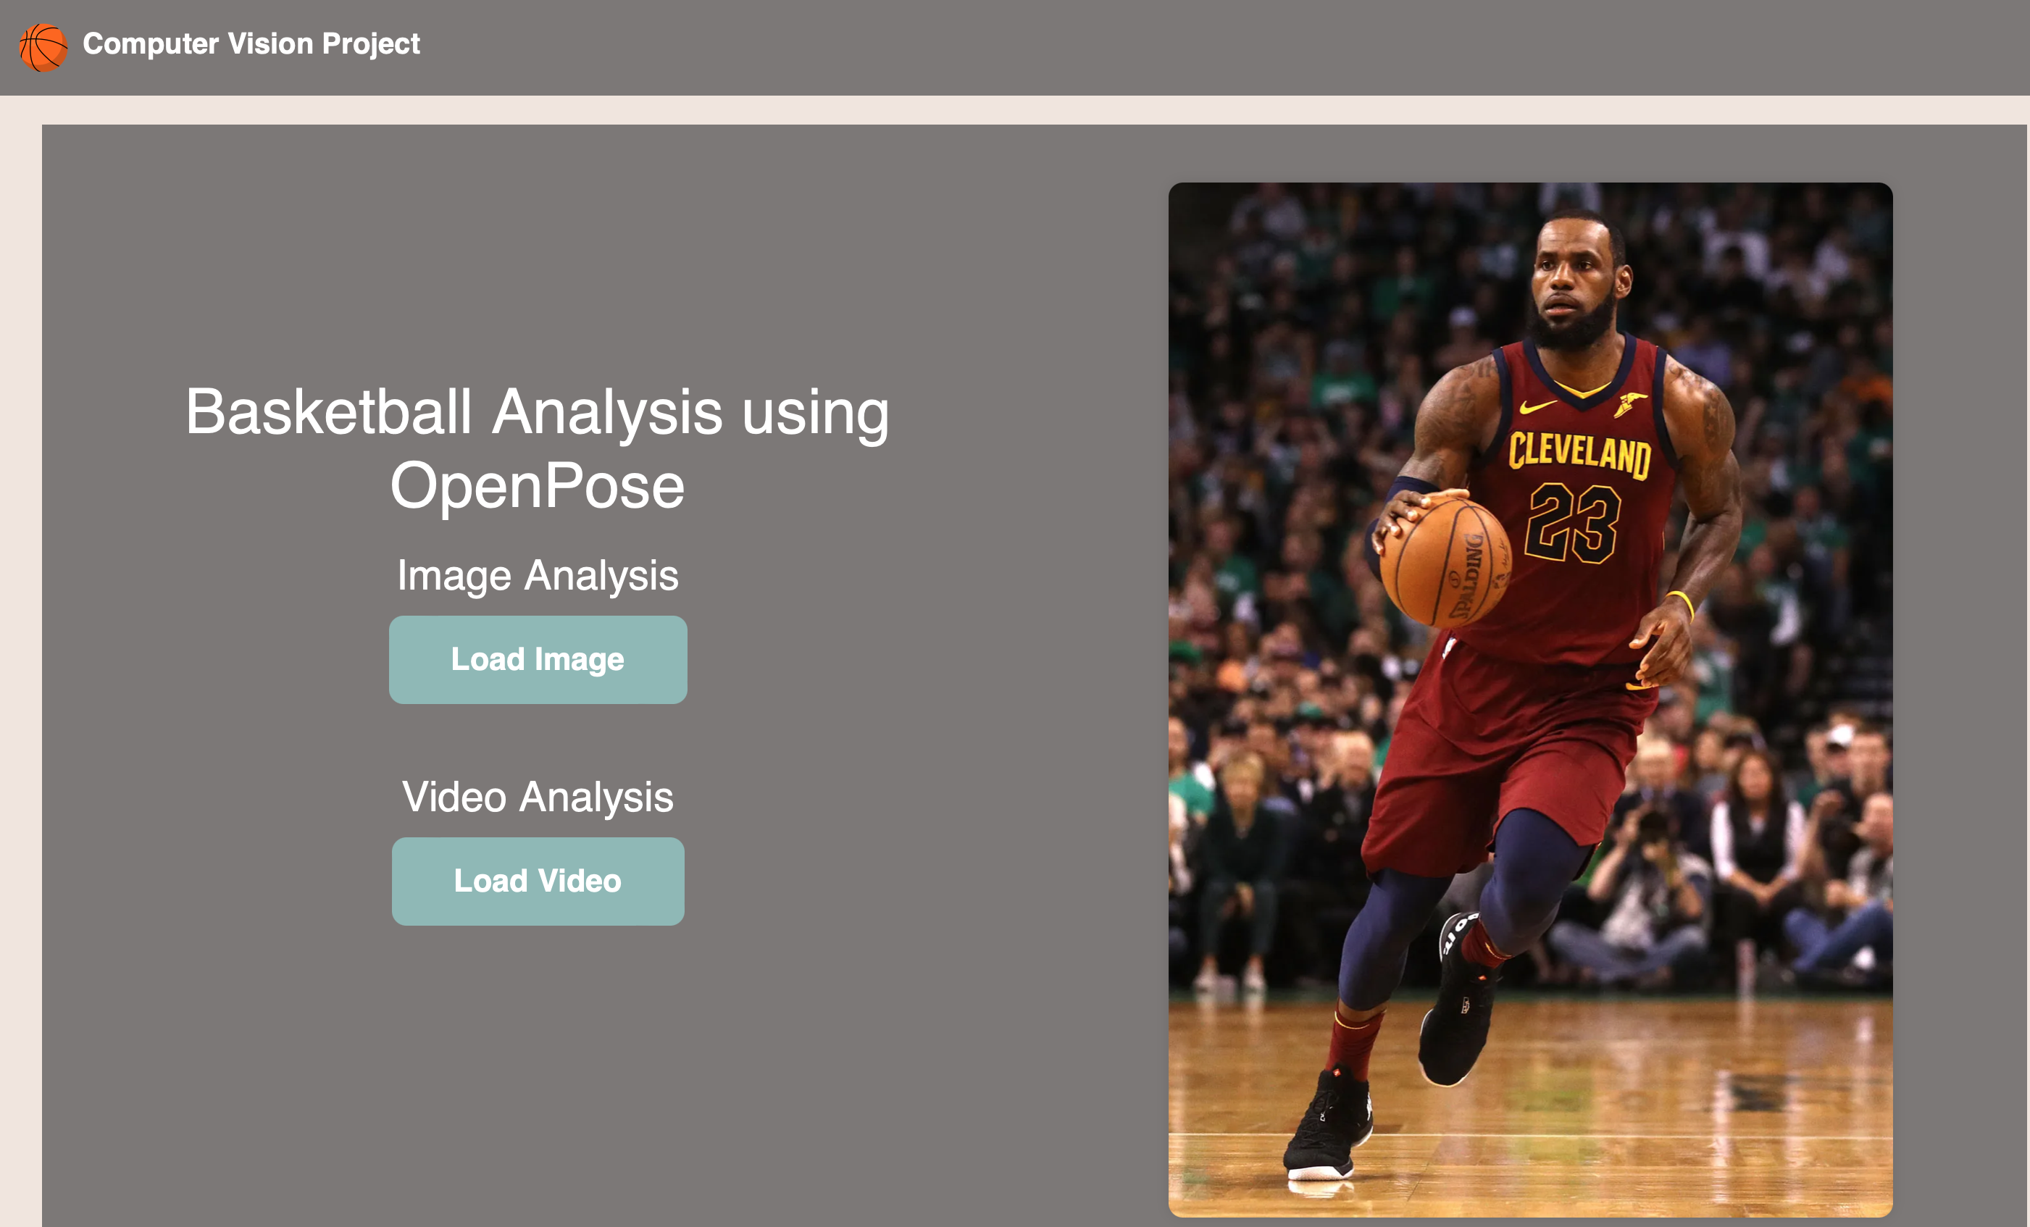

Slide 15
Client Side
Uploading Data: Users can upload videos or images directly to the web application for analysis of basketball shots and shooting poses.
API Integration: It includes a POST request interface (./detection_json) where users can submit images to receive JSON responses detailing shot detections.
Visualization: Displays shot and pose analysis results through visual indicators such as colored keypoints (e.g., blue for basketball, green for successful shots).

Slide 16
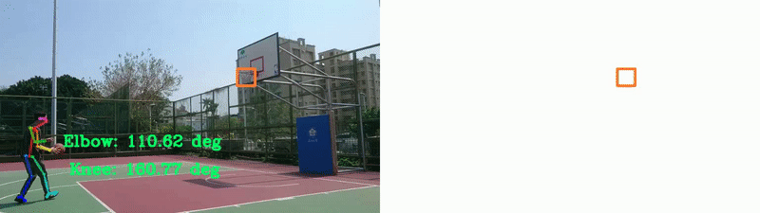
Results

Slide 17
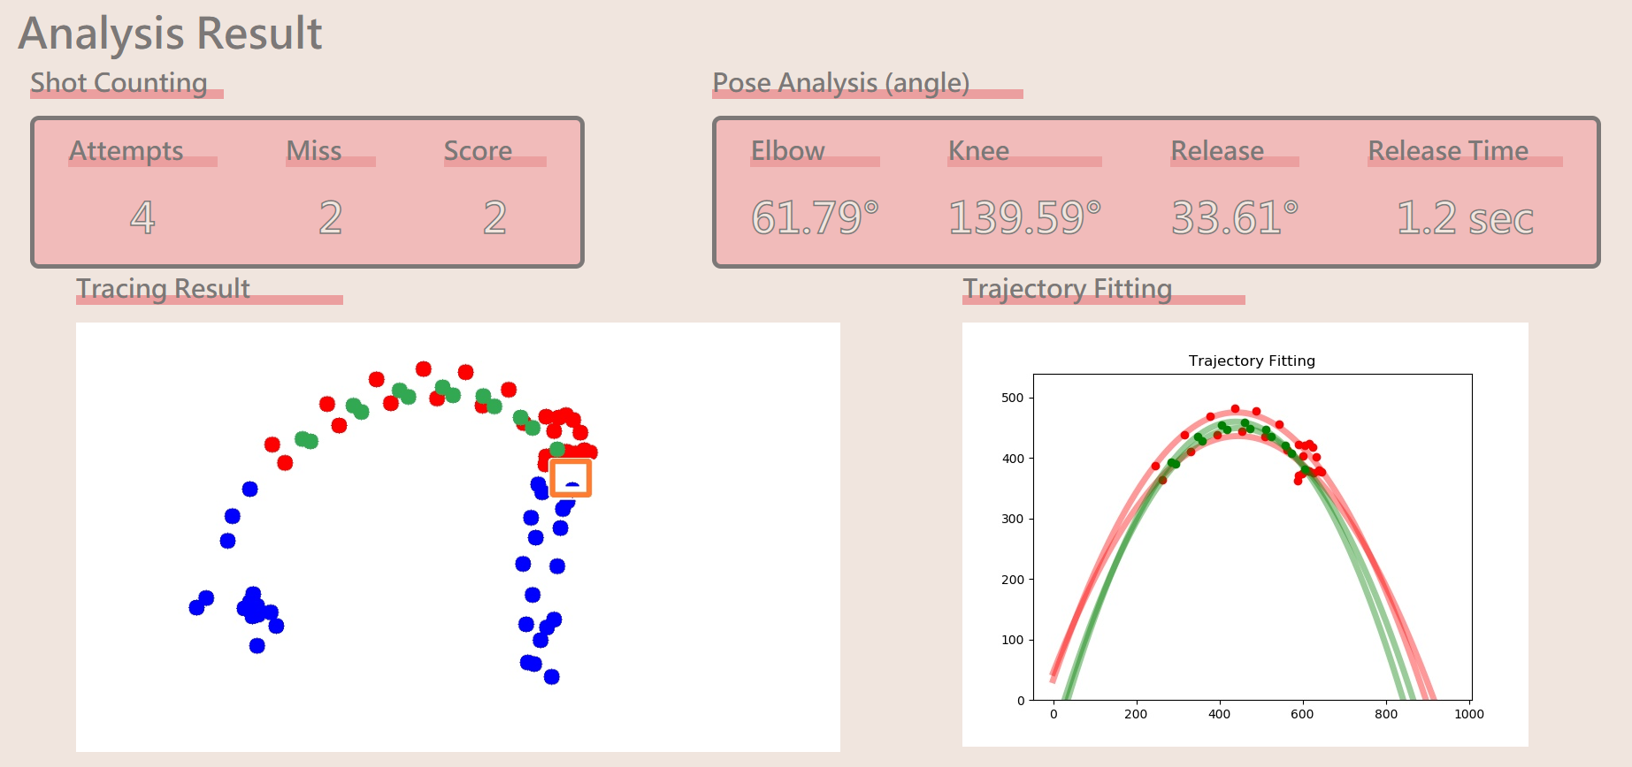

Slide 18
Future Enhancements
Plans include transitioning to YOLOv4 for efficiency to reduce false detections.
Aiming to improve visual presentation and computational efficiency.
Enhance efficiency to enable seamless execution on web application platforms.

Slide 19
References
Z. Cao, G. Hidalgo, T. Simon, S. -E. Wei and Y. Sheikh, "OpenPose: Realtime Multi-Person 2D Pose Estimation Using Part Affinity Fields," in IEEE Transactions on Pattern Analysis and Machine Intelligence, vol. 43, no. 1, pp. 172-186, 1 Jan. 2021, doi: 10.1109/TPAMI.2019.2929257.
S. Ren, K. He, R. Girshick and J. Sun, "Faster R-CNN: Towards Real-Time Object Detection with Region Proposal Networks," in IEEE Transactions on Pattern Analysis and Machine Intelligence, vol. 39, no. 6, pp. 1137-1149, 1 June 2017, doi: 10.1109/TPAMI.2016.2577031.
Nakai, Masato & Tsunoda, Yoshihiko & Hayashi, Hisashi & Murakoshi, Hideki. (2019). Prediction of Basketball Free Throw Shooting by OpenPose. 10.1007/978-3-030-31605-1_31.
https://github.com/CMU-Perceptual-Computing-Lab/openpose
https://www.tensorflow.org/api_docs/python/tf/compat/v1
https://docs.opencv.org/4.x/d6/d00/tutorial_py_root.html
https://flask.palletsprojects.com/en/3.0.x/
https://github.com/lxaw/PoseAngleEstimation

Slide 20
References
https://stackoverflow.com/questions/69154914/calculating-angles-of-body-skeleton-in-video-using-openpose
https://github.com/Practical-CV/Color-Based-Ball-Tracking-With-OpenCV
https://pyimagesearch.com/2015/09/14/ball-tracking-with-opencv/
https://www.digitalocean.com/community/tutorials/how-to-make-a-web-application-using-flask-in-python-3

Slide 21
THANK YOU

